Slide 1

Epigenome data mining to understand disease predisposition
Stephen C. J. Parker
Assistant Professor
University of Michigan
email: scjp@umich.edu
web: theparkerlab.org

Slide 2

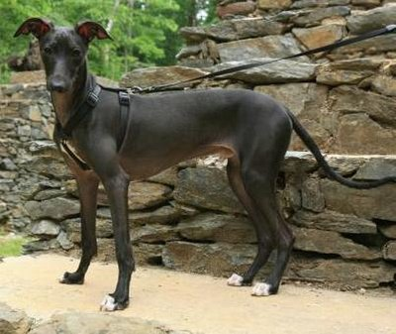

Athletic Performance (coding mutation)
Whippet
Bully Whippet
Mosher, D. S. et al. A Mutation in the Myostatin Gene Increases Muscle Mass and
Enhances Racing Performance in Heterozygote Dogs. PLoS Genet 3, e79 (2007).

Slide 3
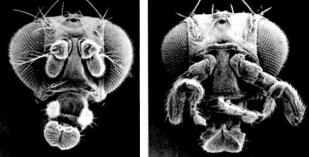
Antennapedia mutant (non-coding mutation)
Notes:
For more information about how to format text boxes, add images and print handouts in Powerpoint:
Select Help
Select Microsoft Office Powerpoint Help
Search for assistance

Slide 4
Agenda
Motivation to study the non-coding genome
Regulatory variations
Cross-species comparisons
High-impact rare variations
Common disease genetic predisposition
Measuring and quantifying epigenome signatures
Histone covalent modifications
Chromatin accessibility
Mining epigenome signatures to understand disease
Future directions

Slide 5
How can a single genome give rise to the diverse cell types of an animal?

Slide 6
The Language of the Genome
Coding Sequences (i.e., Genes)
+
-
+
+
-
-
Non-Coding regulatory elements
Notes:
For more information about how to format text boxes, add images and print handouts in Powerpoint:
Select Help
Select Microsoft Office Powerpoint Help
Search for assistance

Slide 7
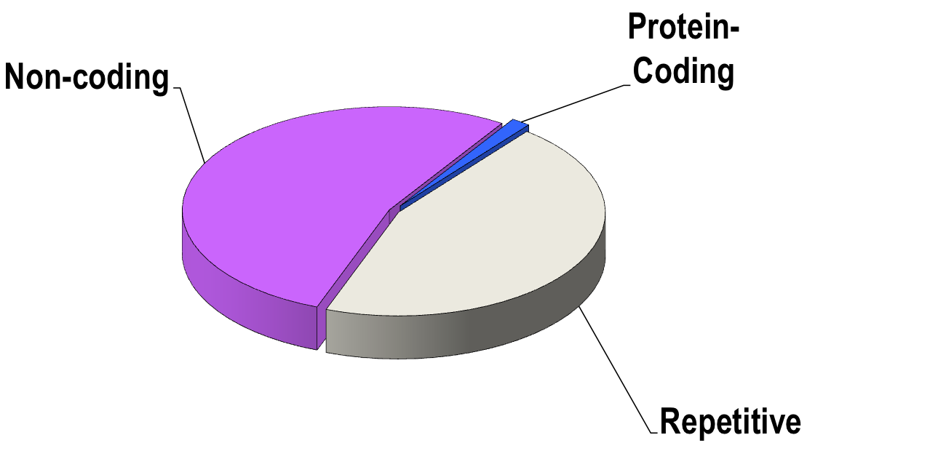
Decoding the Human Genome
What other functions exist?
Where are they encoded?
How are they encoded?

Slide 8
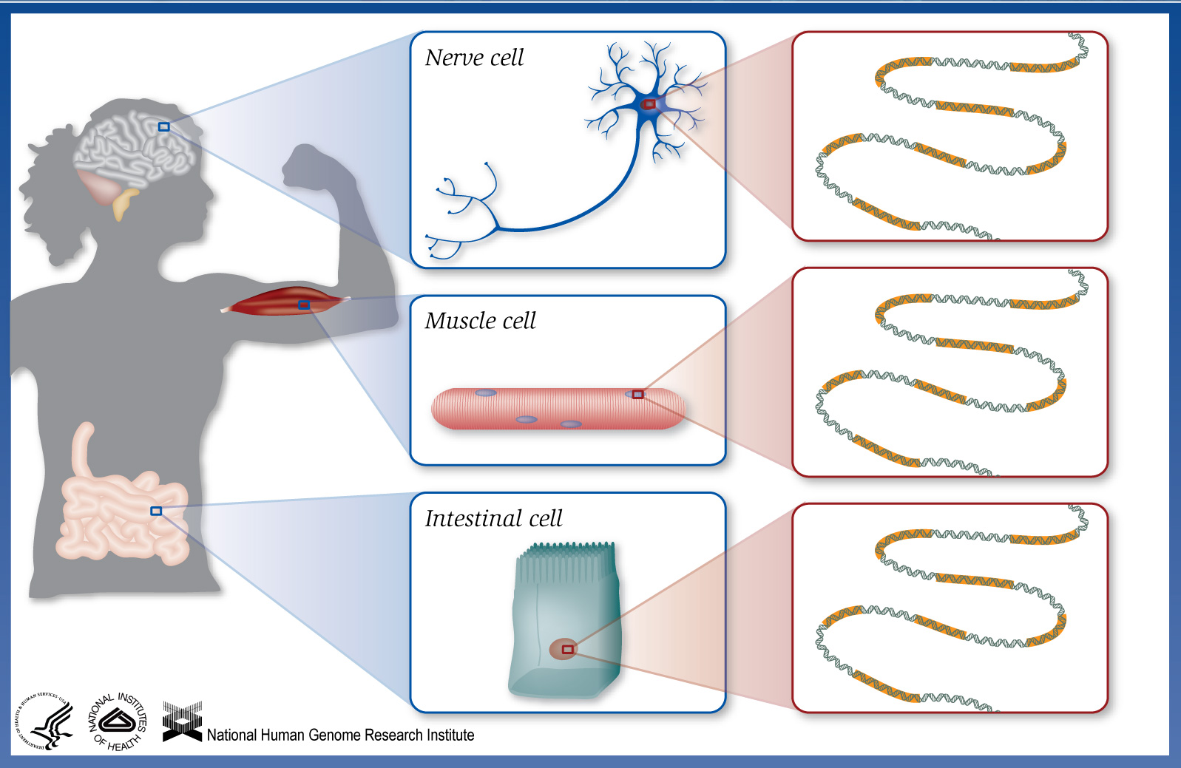
All cells have (generally) the same genetic material
Notes:
Every cell in our body contains a copy of the exact same genetic code. This means that each of our cells contain every gene needed to produce every protein. BUT every cell doesn’t produce every protein - they only produce the proteins needed by their particular cell type.

Slide 9
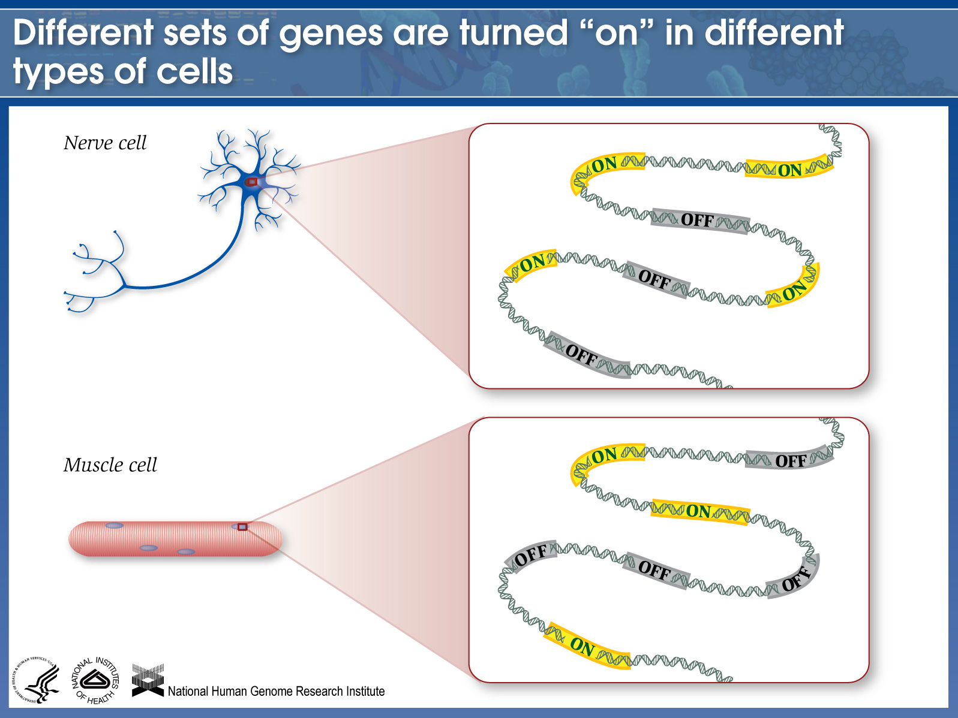
Notes:
Our body’s ability to turn genes on and off is what allows us to have many different kinds of cells that do different jobs. For example, a nerve cell has some genes turned on and other genes turned off. And a muscle cell has a different set of active and inactive genes. Point to the different genes that are on and off in each cell type.

Slide 10
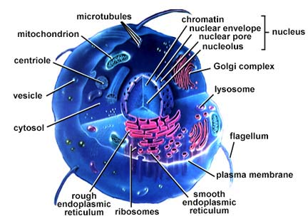
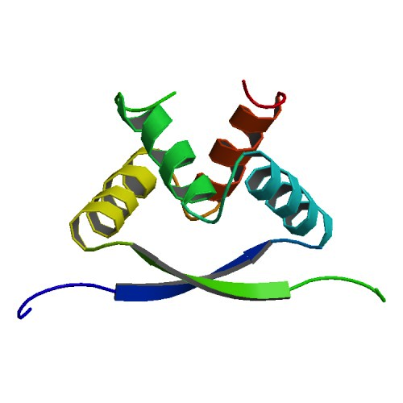
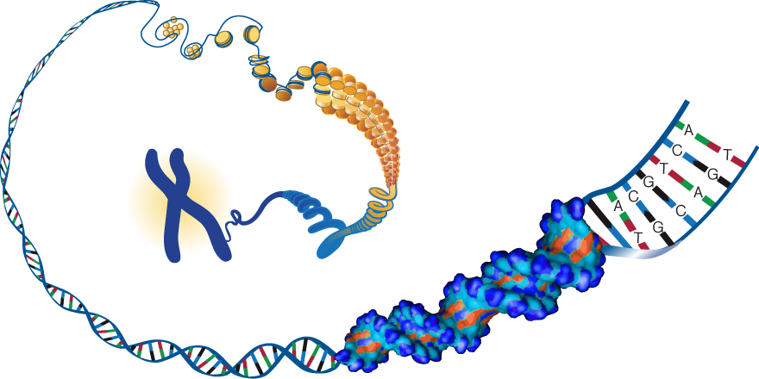
Protein transcription factors (TFs) recognize DNA regulatory elements
http://www.ebi.ac.uk/microarray/biology_intro_files/cell.jpe

Slide 11
Regulatory Elements tend to have Motifs
What is a “Motif”?
A recurring pattern.
E.g.
Sequence motif
Structure motif
Network motif

Slide 12
Example: Transcription Factor Binding Sites
Estrogen
Receptor
Transcription factor
Genes regulated by Estrogen Receptor
Efp
TERT
Oxytocin
Lactoferrin
Angiotensin
VEGF

Slide 13
Example: Transcription Factor Binding Sites
Estrogen
Receptor
Transcription start
ERE
DNA
(estrogen response element)
Genes regulated by Estrogen Receptor
Efp
TERT
Oxytocin
Lactoferrin
Angiotensin
VEGF

Slide 14
Example: Transcription Factor Binding Sites
Estrogen
Receptor
Transcription start
ERE
DNA
(estrogen response element)
Gene | ERE Sequence
Efp | … a g g g t c a t g g t g a c c c t …
TERT | … t t g g t c a g g c t g a t c t c …
Oxytocin | … g c g g t g a c c t t g a c c c c …
Lactoferrin | … c a g g t c a a g g c g a t c t t …
Angiotensin | … t a g g g c a t c g t g a c c c g …
VEGF | … a t a a t c a g a c t g a c t g g …

Slide 15
How can we mathematically describe binding site preferences?
Gene | ERE Sequence
Efp | … a g g g t c a t g g t g a c c c t …
TERT | … t t g g t c a g g c t g a t c t c …
Oxytocin | … g c g g t g a c c t t g a c c c c …
Lactoferrin | … c a g g t c a a g g c g a t c t t …
Angiotensin | … t a g g g c a t c g t g a c c c g …
VEGF | … a t a a t c a g a c t g a c t g g …

Slide 16
A Probability Matrix (PWM, PSSM) [Position Weight Matrix, Position-Specific Scoring Matrix]
 | 1 | 2 | 3 | 4 | 5 | 6
A | 0.05 | 0.85 | 0.05 | 0.85 | 0.7 | 0.85
C | 0.1 | 0.02 | 0.05 | 0.02 | 0.025 | 0.02
G | 0.05 | 0.03 | 0.05 | 0.03 | 0.025 | 0.1
T | 0.8 | 0.1 | 0.85 | 0.1 | 0.25 | 0.03

Slide 17
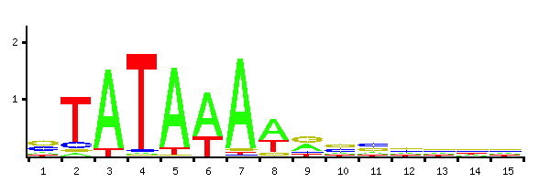
TBP binding site (TATA-box)
From JASPAR database: http://jaspar.genereg.net/

Slide 18
Sequence Logos
Sequence logos are a graphical representation of an amino acid or nucleic acid multiple sequence alignment developed by Tom Schneider and Mike Stephens.
Each logo consists of stacks of symbols, one stack for each position in the sequence. The overall height of the stack indicates the information at that position, while the height of symbols within the stack indicates the relative frequency of each amino or nucleic acid at that position.
In general, a sequence logo provides a richer and more precise description of, for example, a binding site, than would a consensus sequence.
References
Crooks GE, Hon G, Chandonia JM, Brenner SE WebLogo: A sequence logo generator, Genome Research, 14:1188-1190, (2004)
Schneider TD, Stephens RM. 1990. Sequence Logos: A New Way to Display Consensus Sequences. Nucleic Acids Res. 18:6097-6100
Website: http://weblogo.berkeley.edu/

Slide 19
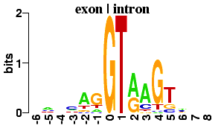
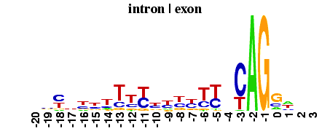
Example: Splicing Signals
Exon <-|-> Intron
Intron <-|-> Exon

Slide 20
Measuring Motif Information: Shannon Entropy
Entropy is the measure of average uncertainty of an outcome. Random Variable Y has K possible outcomes: y₁, y₂, … y_{K}.
The base of the log is often 2, and in this case the unit of entropy is in bits.

Slide 21
Theoretical Question: Entropy calculation
What is the entropy if all four nucleotides are equally likely?
What is the entropy if only A is allowed at a position?
Notes:
The entropy is maximized when all the P(Yi) are equal, and the entropy is log(K) in this case. In the latter case the entropy is 0.

Slide 22
Practical Solution
Position counts
1
2
3
4
a
1
4
0
3
c
1
0
2
1
g
1
0
2
0
t
1
0
0
0
1. H(1) = -( P(A) log(P(A) + P(C) log(P(C) + P(G) log(P(G) + P(T) log(P(T))
H(1) = -( (0.25 x log(0.25)) x 4) = 2
2. H(2) = -( 1 x log(1) + (0 x log(0)) x 3) = 0
NOTE: use log base 2 to get bits

Slide 23
TBP binding site (TATA-box)
information
NOTE: Information = Max possible entropy - observed entropy
From JASPAR database: http://jaspar.genereg.net/

Slide 24
Agenda
Motivation to study the non-coding genome
Regulatory variations
Cross-species comparisons
High-impact rare variations
Common disease genetic predisposition
Measuring and quantifying epigenome signatures
Histone covalent modifications
Chromatin accessibility
Mining epigenome signatures to understand disease
Future directions

Slide 25
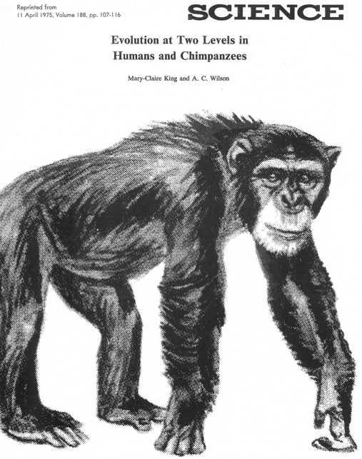
King and Wilson, 1975
“… small number of genetic changes in systems controlling the expression of genes may account for the major organismal differences between humans and chimpanzees.”
Non-coding sequences
are important!

Slide 26
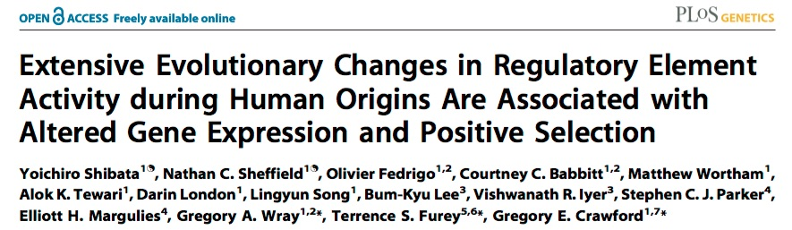

Slide 27
Mutations in far-away regulatory sequences can have dramatic consequences
Reviewed in Axel Visel et al., 2009 (Nature: 461;pp.199-205)

Slide 28
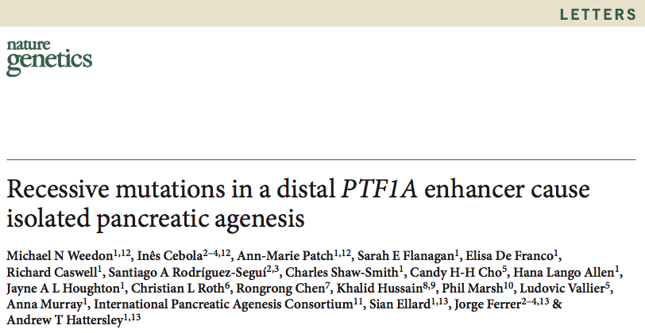
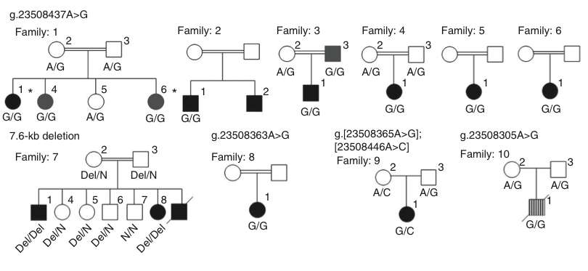
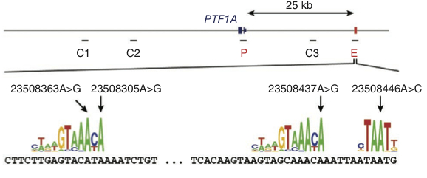

Slide 29
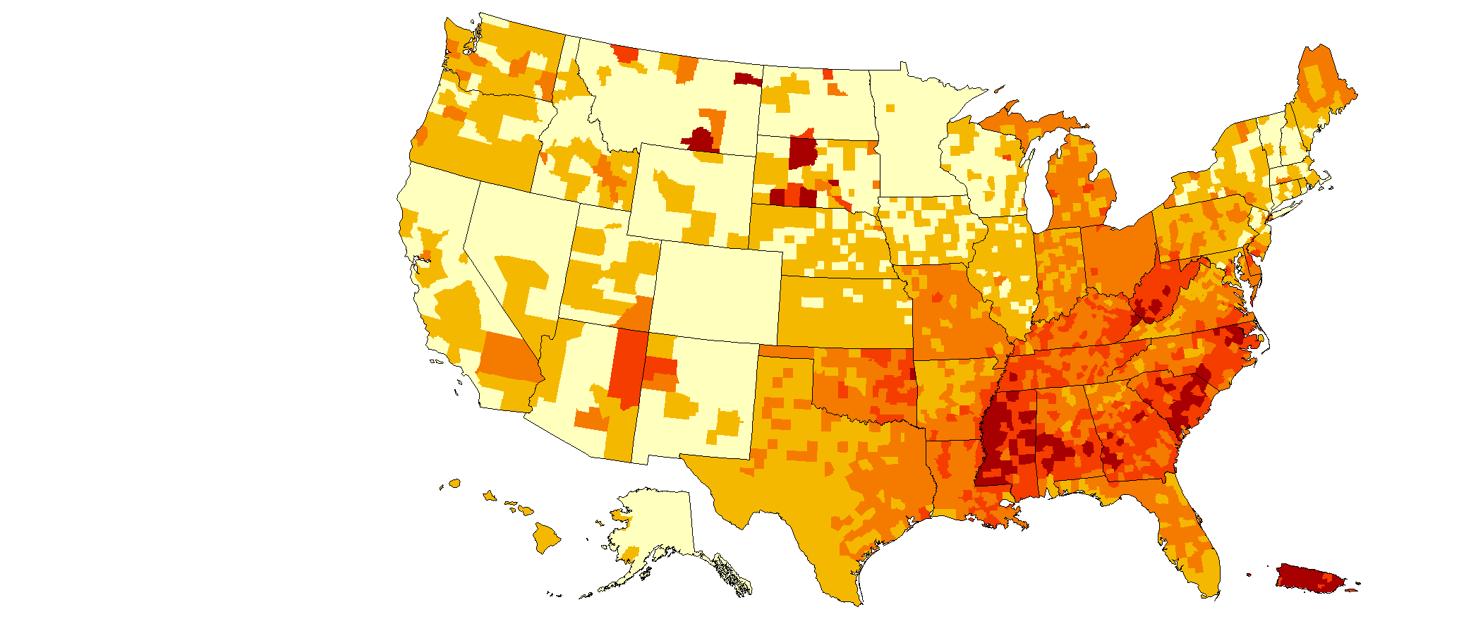
Age-adjusted County-level Estimates of Diagnosed Diabetes among Adults aged ≥ 20 years: United States 2004
Age-adjusted percent
www.cdc.gov/diabetes

Slide 30

Age-adjusted County-level Estimates of Diagnosed Diabetes among Adults aged ≥ 20 years: United States 2005
Age-adjusted percent
www.cdc.gov/diabetes

Slide 31
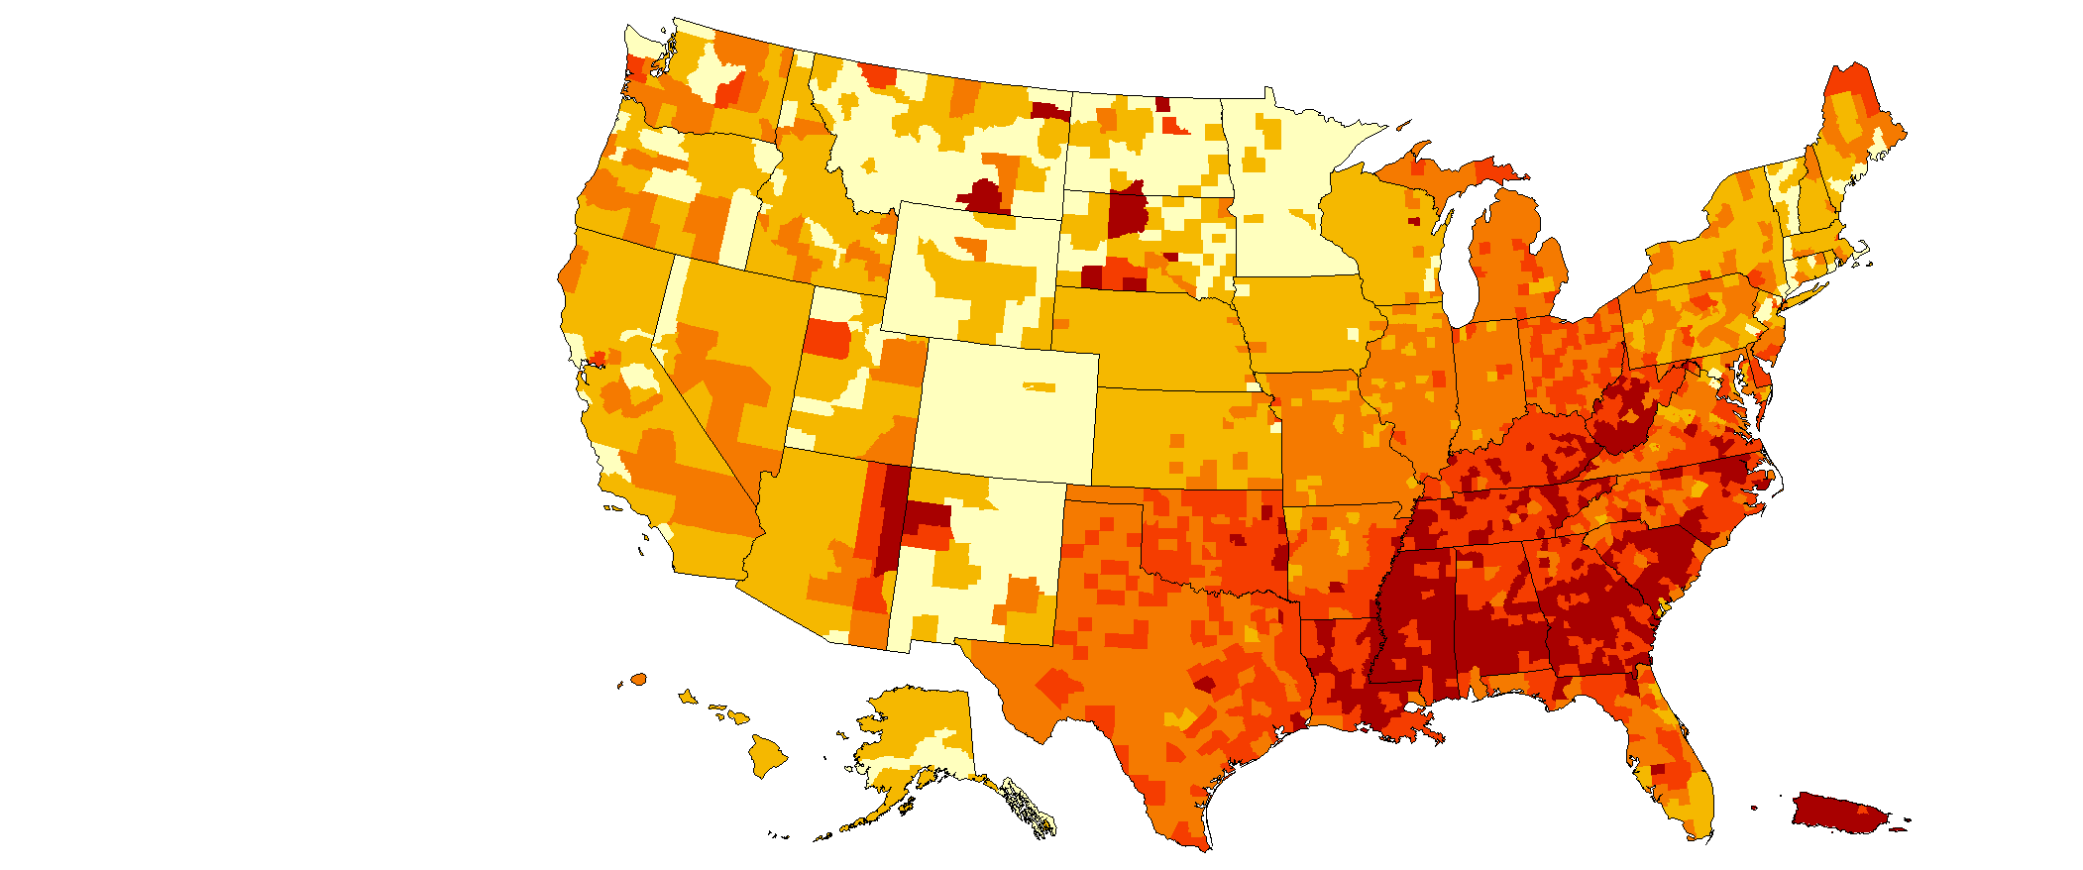
County-level Estimates of Diagnosed Diabetes among Adults aged ≥ 20 years: United States 2006
Age-adjusted percent
www.cdc.gov/diabetes

Slide 32
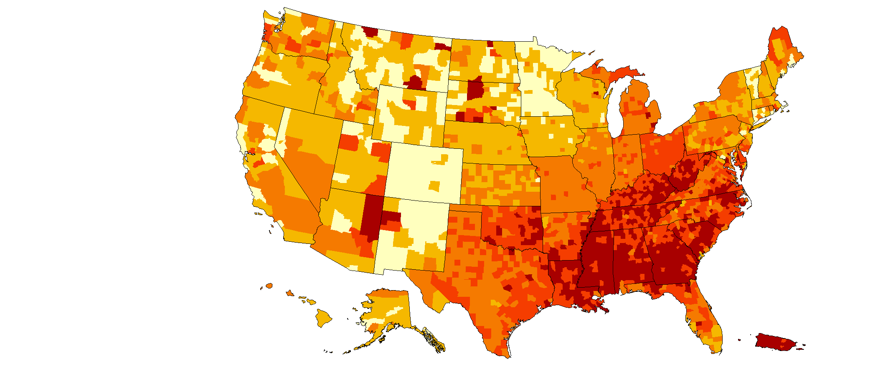
Age-adjusted County-level Estimates of Diagnosed Diabetes among Adults aged ≥ 20 years: United States 2007
Age-adjusted percent
www.cdc.gov/diabetes

Slide 33
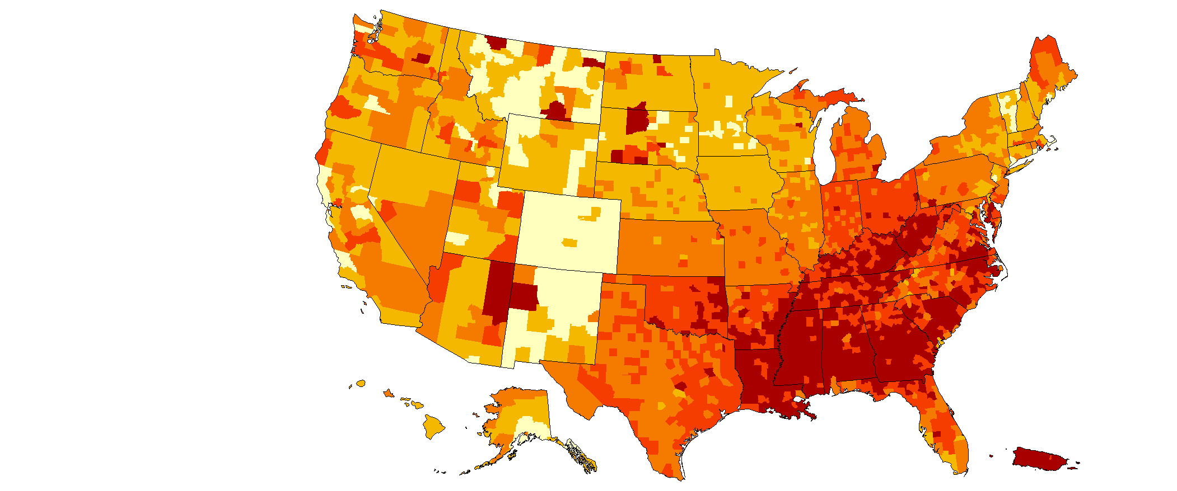
Age-adjusted County-level Estimates of Diagnosed Diabetes among Adults aged ≥ 20 years: United States 2008
Age-adjusted percent
www.cdc.gov/diabetes

Slide 34

Age-adjusted County-level Estimates of Diagnosed Diabetes among Adults aged ≥ 20 years: United States 2009
Age-adjusted percent
www.cdc.gov/diabetes

Slide 35
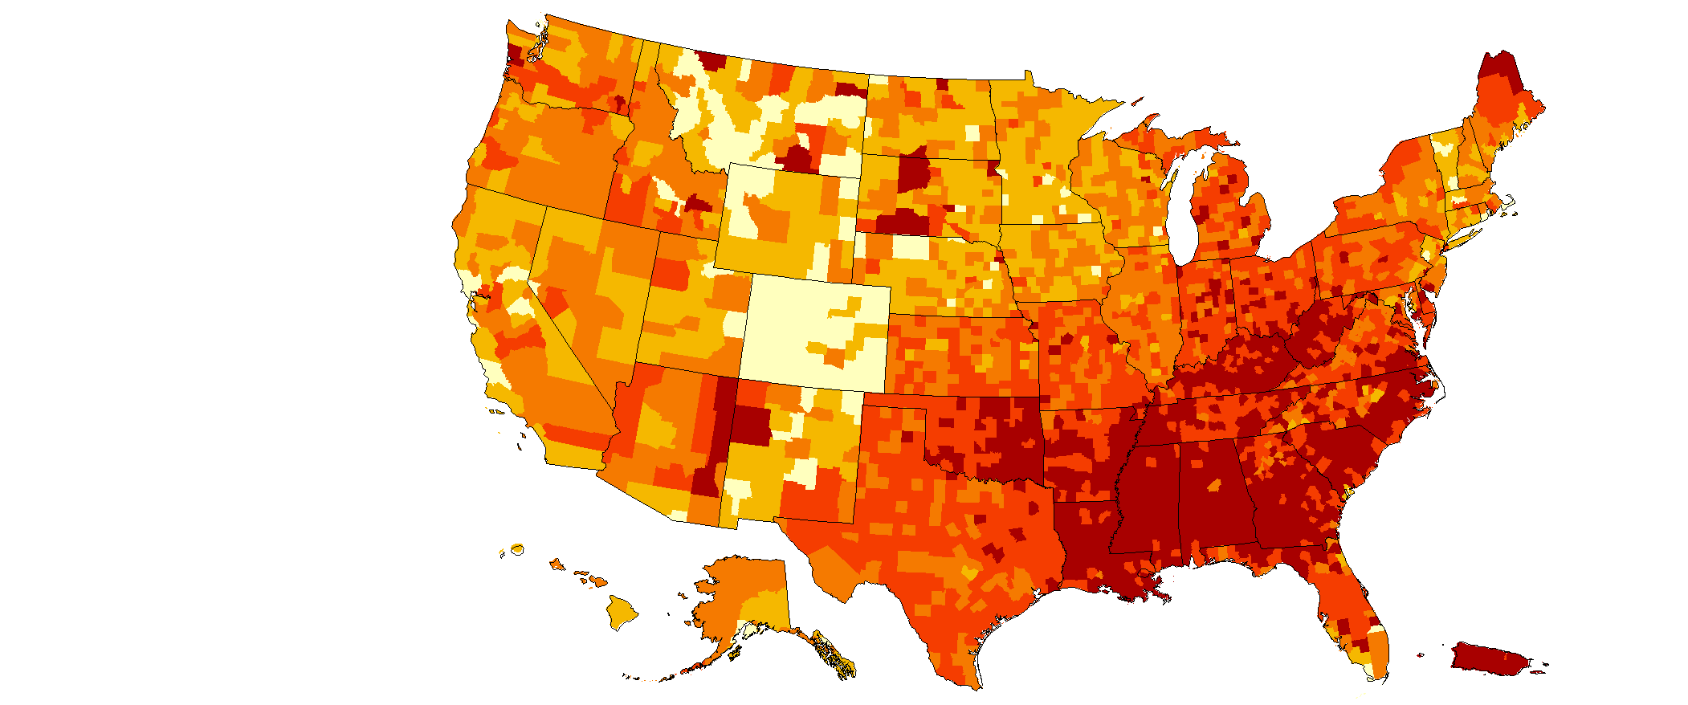
Age-adjusted County-level Estimates of Diagnosed Diabetes among Adults aged ≥ 20 years: United States 2010
Age-adjusted percent
www.cdc.gov/diabetes

Slide 36
Type 2 Diabetes (T2D)
90-95% of all diabetes cases, afflicting 25.8 million Americans (8.3% of population)
Characterized by insulin resistance and impaired pancreatic islet function
Complex interaction between genetic and environmental risk factors
Medical costs
2-4 fold increased risk of heart disease and stroke
Kidney failure, blindness, lower limb amputations
Financial cost estimate: $174 billion annually
Projected to increase ~3X over next 25 years
79 million people > 20 years old are prediabetic
County-level estimates of diagnosed diabetes
among adults aged ≥ 20 years (CDC; 2010).

Slide 37
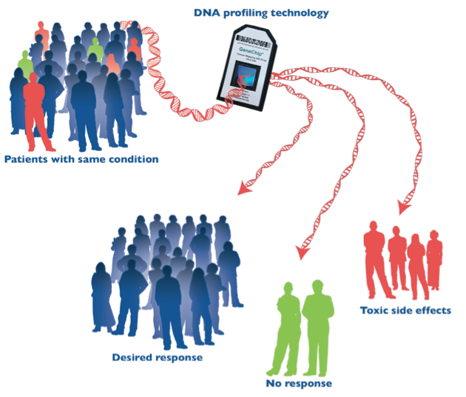
Genome Wide Association Study (GWAS)

Slide 38
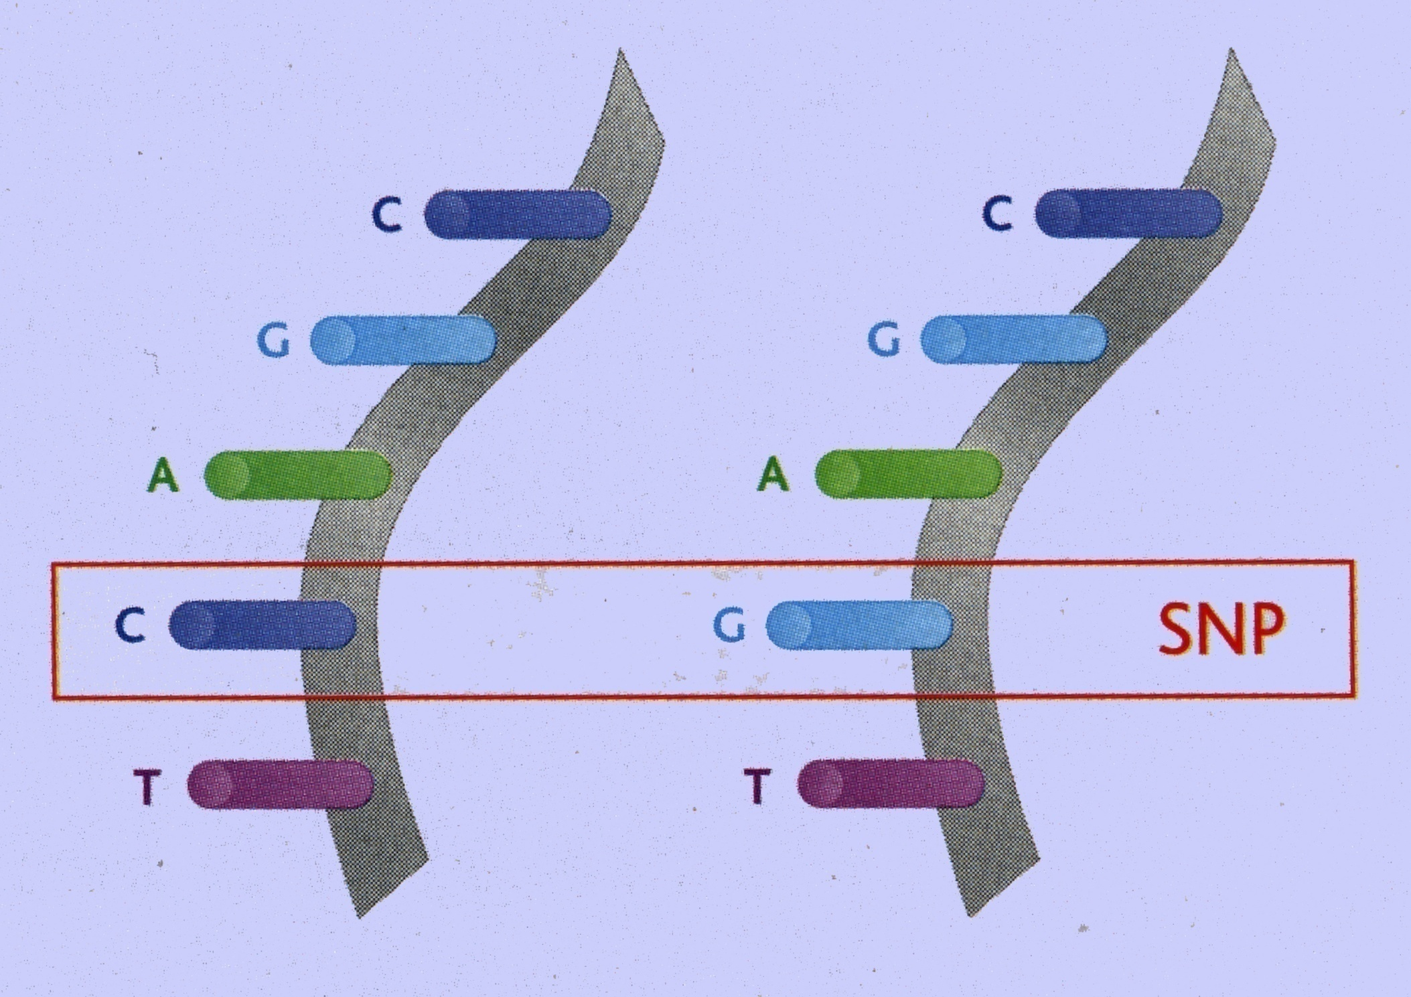
Genome-Wide Association Studies (GWAS) look for Single nucleotide polymorphisms (SNPs)

Slide 39
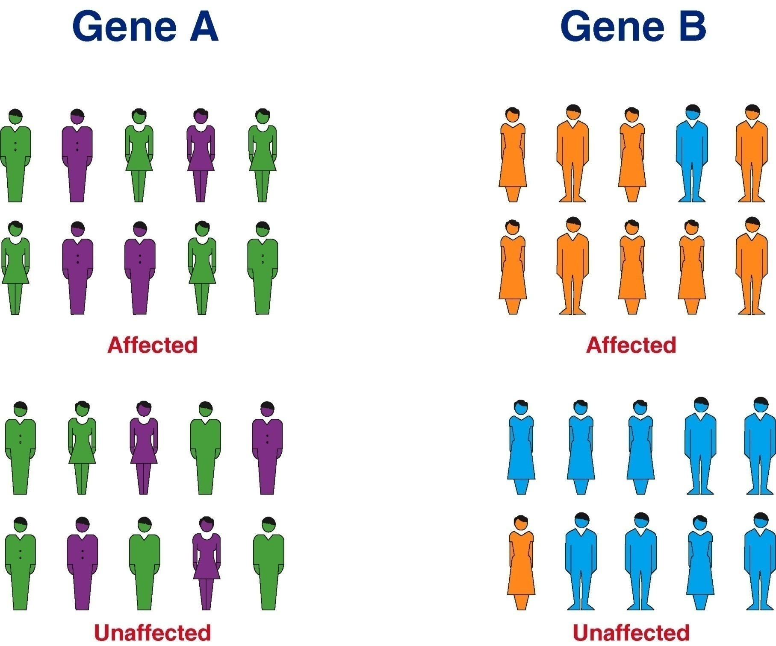
SNP A
SNP B

Slide 40
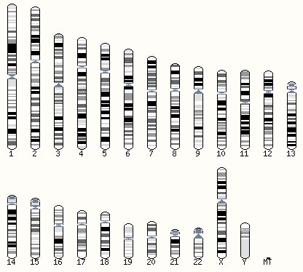
Candidate gene
T2D genetic
landscape (pre-GWAS)
Candidate
pathway
PPARG
WFS1
KCNJ11
INS
HNF1A
HNF1B
HNF4A
Adapted from McCarthy, 2011 (NEJM)

Slide 41
Candidate gene
T2D GWA
European
Glucose GWA
GCKR
Candidate
pathway
T2D GWA
Non European
BMI GWA
THADA
“Partial” GWA
BCL11A
PPARG
WFS1
UBE2E2
CDKAL1
DGKB
ADAMTS9
JAZF1
PTPRD
DUSP8
NOTCH2
CDC123
KCNQ1
GCK
CDKN2A
KCNJ11
ZBED3
RBMS1
GRB14
ADCY5
VPS26A
HMGA2
TP53INP1
CHCHD9
CENTD2
TSPAN8
SLC30A8
HHEX
MTNR1B
SPRY2
PROX1
IGF2BP2
KLF14
TCF7L2
IRS1
HNF1A
ST6GAL1
2011
N=49
SRR
C2CD4A
FTO
HNF1B
HMG20A
ZFAND6
HNF4A
AP3S2
PRC1
DUSP9
Adapted from McCarthy, 2011 (NEJM)

Slide 42
T2D GWAS hits are mostly non-coding
T2D
(N = 86)
Non-coding genome often “on” in cell-specific manner
non-coding
coding
Annotation = GENCODE V12 on GRCh37
GWAS = NHGRI Catalog downloaded on Dec. 10, 2012

Slide 43
Published GWAS, 2005 – 6/2011
Total Number of Publications
Calendar Quarter
Through 9/30/10 postings

Slide 44
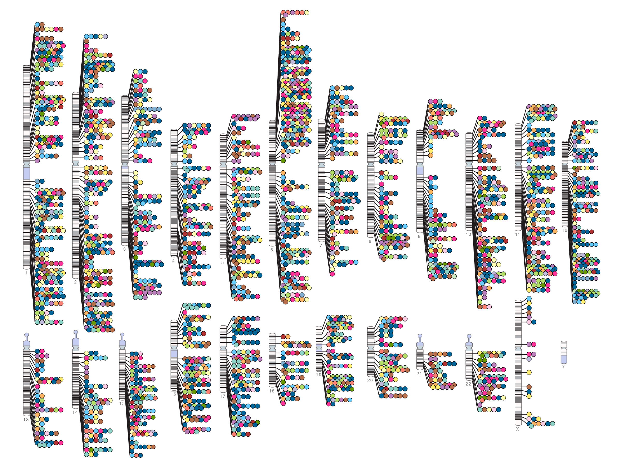
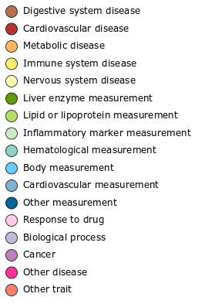

Published Genome-Wide Associations through 12/2012
(p≤5X10⁻⁸ for 17 trait categories)
NHGRI GWA Catalog
www.genome.gov/GWAStudies
www.ebi.ac.uk/fgpt/gwas/

Slide 45
GWAS hits are non-coding
All
(N = 3,285)
T2D
(N = 86)
All GWAS Trait Categories
non-coding
coding
Annotation = GENCODE V12 on GRCh37
GWAS = NHGRI Catalog downloaded on Dec. 10, 2012

Slide 46
Agenda
Motivation to study the non-coding genome
Regulatory variations
Cross-species comparisons
High-impact rare variations
Common disease genetic predisposition
Measuring and quantifying epigenome signatures
Histone covalent modifications
Chromatin accessibility
Mining epigenome signatures to understand disease
Future directions

Slide 47
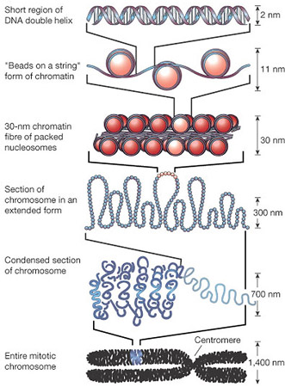
Nuclear Organization
Notes:
Transcription is facilitated by rearrangement of nucleosomes and chromatin
Histone octamers surrounded by 147bp of DNA

Slide 48
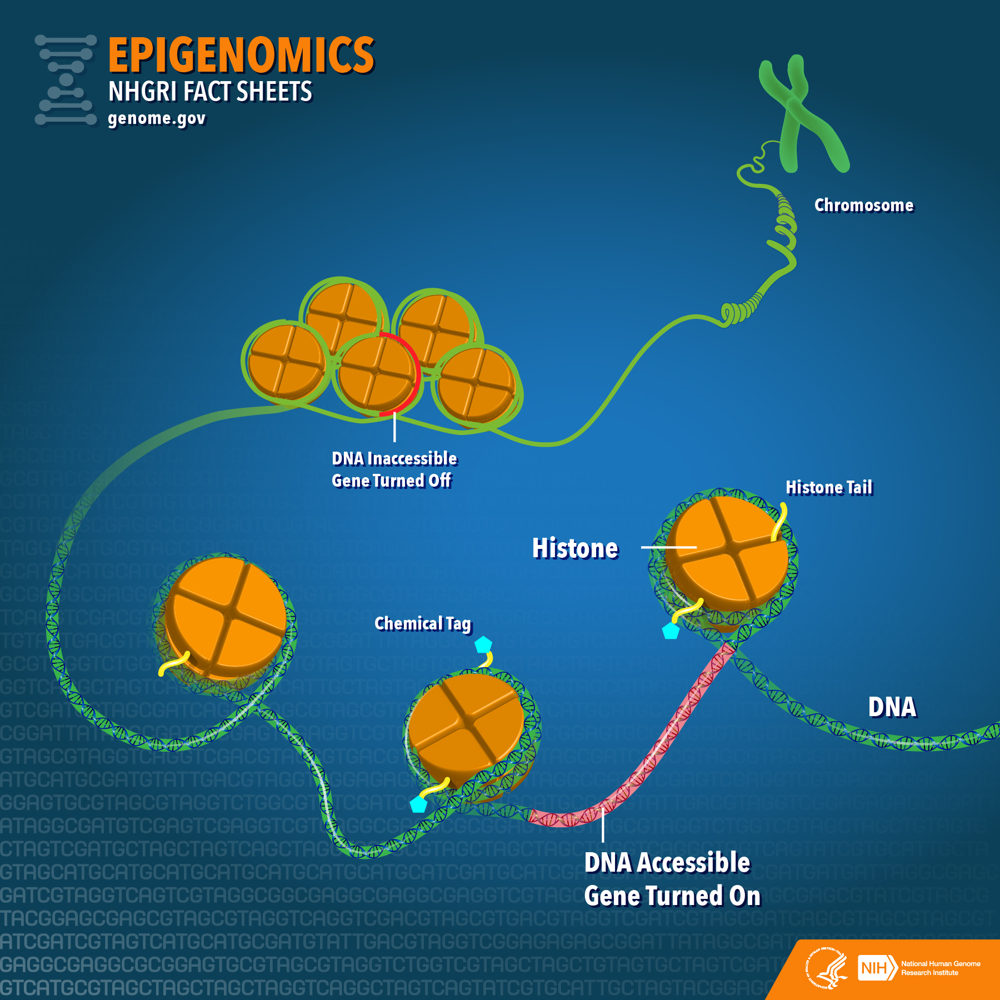

Slide 49
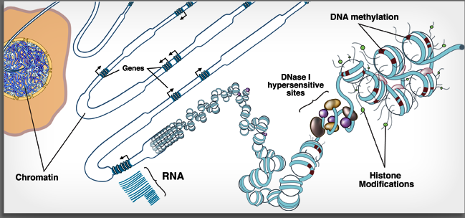
Chromatin signatures illuminate functional genome landscape
Promoter
Transcribed
http://www.roadmapepigenomics.org
Enhancer
Insulator
Repressed
Zhou, Goren, and Bernstein, 2010 (Nat Rev Genetics)

Slide 50
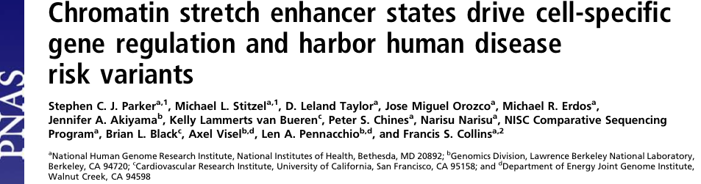
Pancreatic islet chromatin landscape
(signal density in reads per million mapped reads per bp; scale: 0-1)

Slide 51
Pancreatic islet chromatin landscape (200 bp sliding window)
0
0
0
0
0
0
1
0
0
0
1
0
0
0
0
0
0
0
1
1
0
0
0
1
1
1
1
1
1
1
0
0
0
0
0
0
0
0
0
0
0
0
(signal density in reads per million mapped reads per bp; scale: 0-1)
Chromatin states:
1
2
3
4

Slide 52
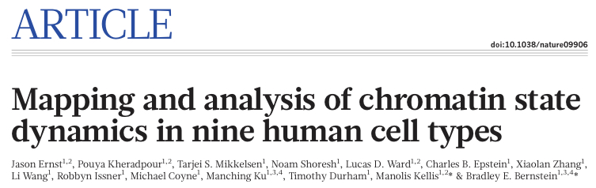

ChromHMM on islets and 9 ENCODE cell types

Slide 53
Islets have common and unique chromatin states
Islets
B-lymphocyte
Embryonic stem cells
Hepatocellular carcinoma
Mammary epithelial
Skeletal muscle myoblasts
Umbilical vein endothelial
Leukemia
Epidermal keratinocytes
Lung fibroblasts

Slide 54
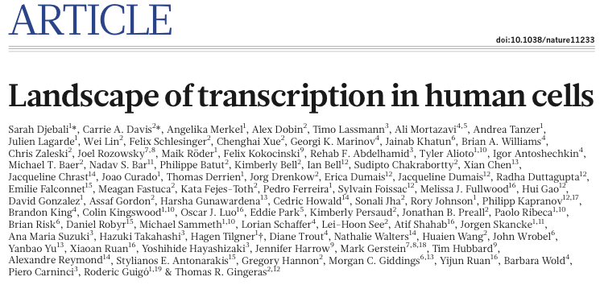
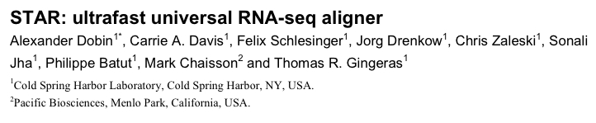
Islets have common and unique chromatin states
Islets
B-lymphocyte
Embryonic stem cells
Hepatocellular carcinoma
Mammary epithelial
Skeletal muscle myoblasts
Umbilical vein endothelial
Leukemia
Epidermal keratinocytes
Lung fibroblasts
[>2.4 Billion reads]

Slide 56
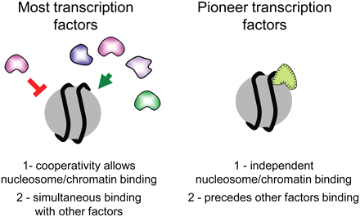
Pioneer Factors
(Carrol and Zaret , 2011 Genes and Dev.)

Slide 57
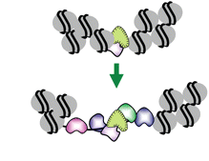
Pioneer Factors
(Carrol and Zaret , 2011 Genes and Dev.)
Notes:
Cell types need specific type-genes

Slide 58
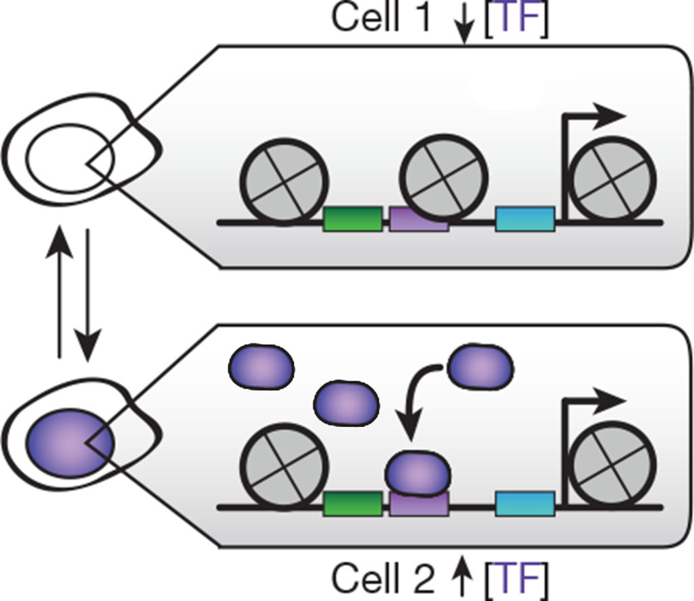
Chromatin Accessibility is Dynamic

Slide 59
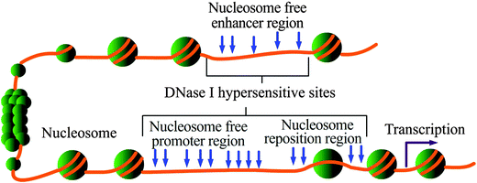
Chromatin Accessibility Assays
Structural rearrangement also leads to vulnerability of the chromatin to various enzymes such as DNase
(Chen et al. 2015 RSoC)
Notes:
Protein-DNA interactions are associated with resistance to cleavage, leaving footprints of open regions

Slide 60
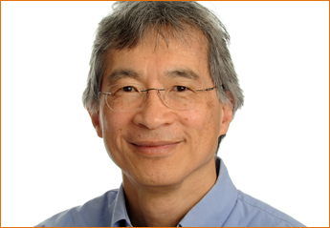
Early DNase Experiments
Investigated regions of the drosophila genome that were hypersensitive to DNase 1
Found DNase Hypersensitivity Sites (DHS) patterning associated with nucleosomes
Also found DHS 5’ to drosophila HSP genes that he theorized could be regulatory regions

Slide 61


Genome Wide DNase experiments
In the mid 2000’s methods were developed to explore DHS genome wide to investigate regulatory regions
Mapped regulatory regions across the entire genome
Notes:
CD4⁺ T Cells

Slide 62
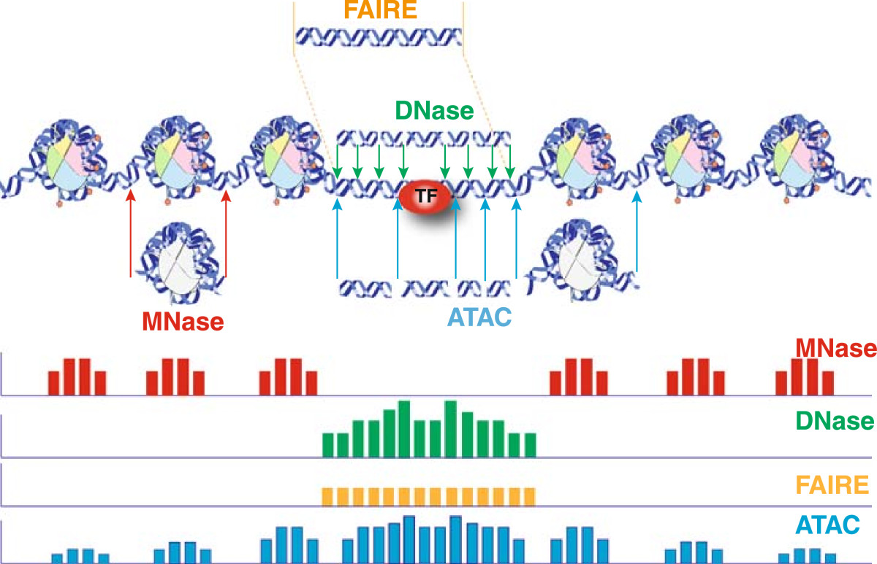
Diverse methods to probe open chromatin
(Tsompana and Buck 2014, Epigenetics and Chromatin)

Slide 63
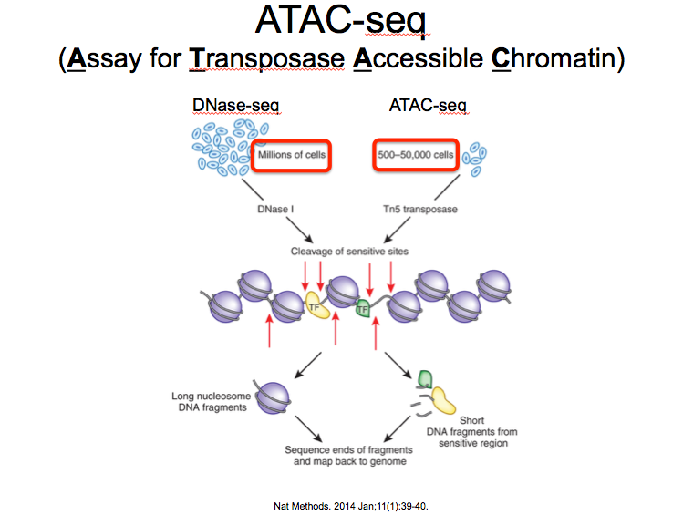

Slide 64
Tn5 Tagmentation

Slide 65
ATAC-seq advantages
DNase-seq, FAIRE-seq, MNase-seq, etc. are resource intensive
ATAC-seq is a quick and efficient alternative
(Buenrostro et al. 2013 Nat. Methods)
Notes:
However it is limited by mito-contamination
Clinical application

Slide 66
ATAC-seq fragment size distribution
(Buenrostro et al. 2013 Nat. Methods)
Notes:
HIGH sensitvity

Slide 67
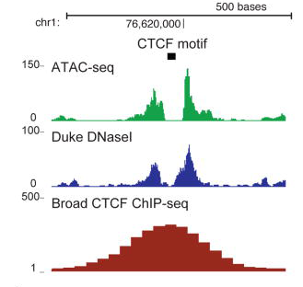
ATAC-seq Footprint
(Buenrostro et al. 2013 Nat. Methods)

Slide 68
Agenda
Motivation to study the non-coding genome
Regulatory variations
Cross-species comparisons
High-impact rare variations
Common disease genetic predisposition
Measuring and quantifying epigenome signatures
Histone covalent modifications
Chromatin accessibility
Mining epigenome signatures to understand disease
Future directions

Slide 69
Islets have common and unique chromatin states
Islets
B-lymphocyte
Embryonic stem cells
Hepatocellular carcinoma
Mammary epithelial
Skeletal muscle myoblasts
Umbilical vein endothelial
Leukemia
Epidermal keratinocytes
Lung fibroblasts
[>2.4 Billion reads]

Slide 70
Proinsulin, glucose, and T2D SNPs are significantly enriched in islet enhancers
Parker*, Stitzel*, et al. PNAS (2013)
Trait (loci)
Replicated:
Ernst et al. Nature (2011)
Cell types

Slide 71

http://www.nature.com/collections/vbqgtr

Slide 72
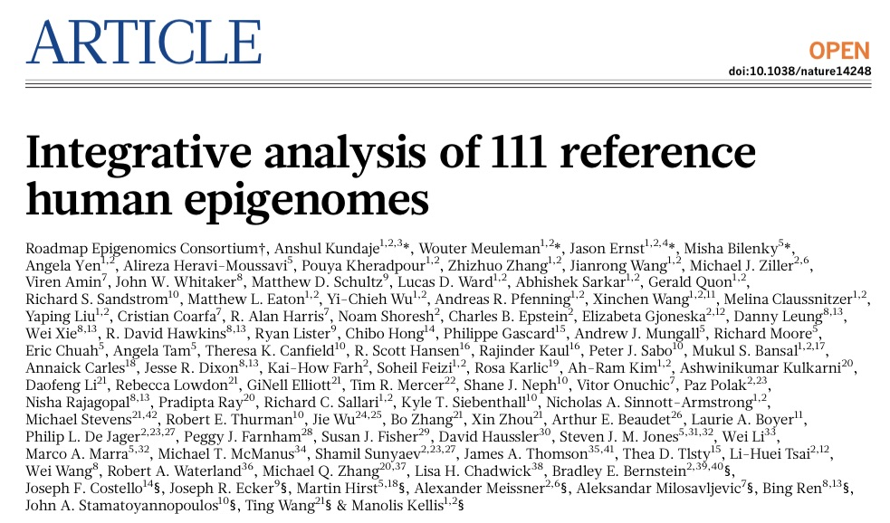
The main paper.

Slide 73
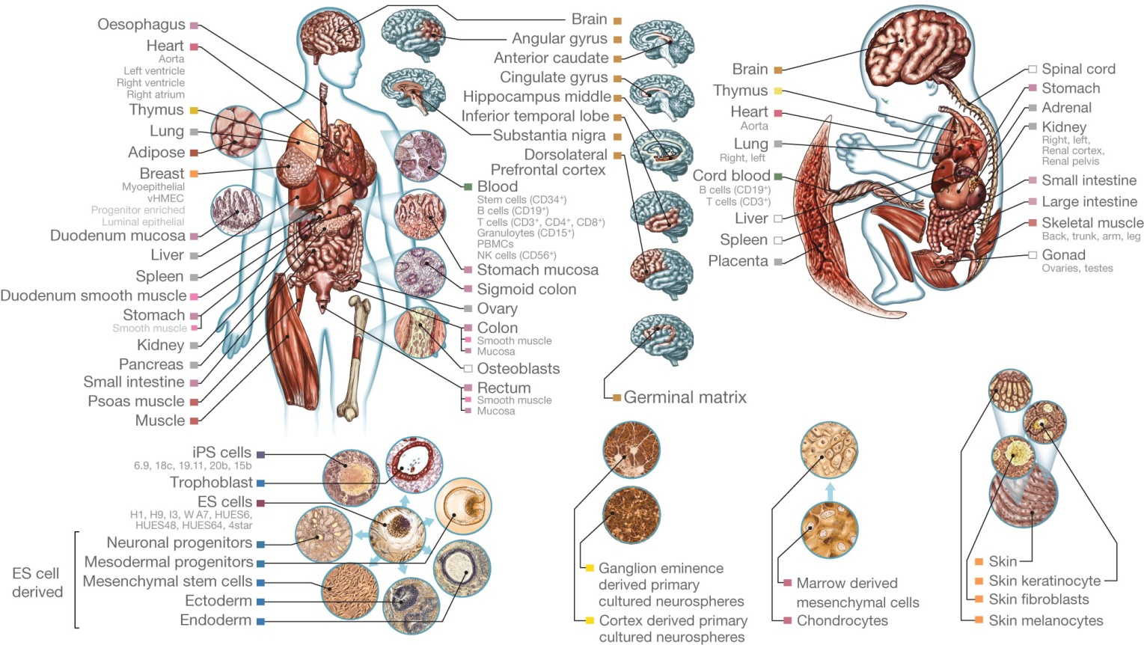
Tissues and cell types profiled in the Roadmap Epigenomics Consortium.

Slide 74
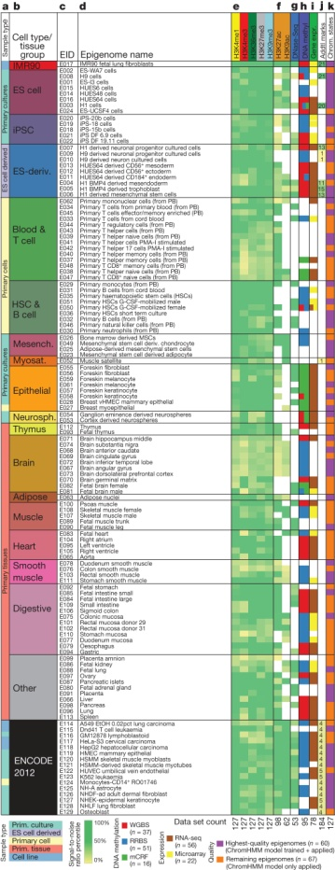

Data sets available for each reference epigenome.

Slide 76
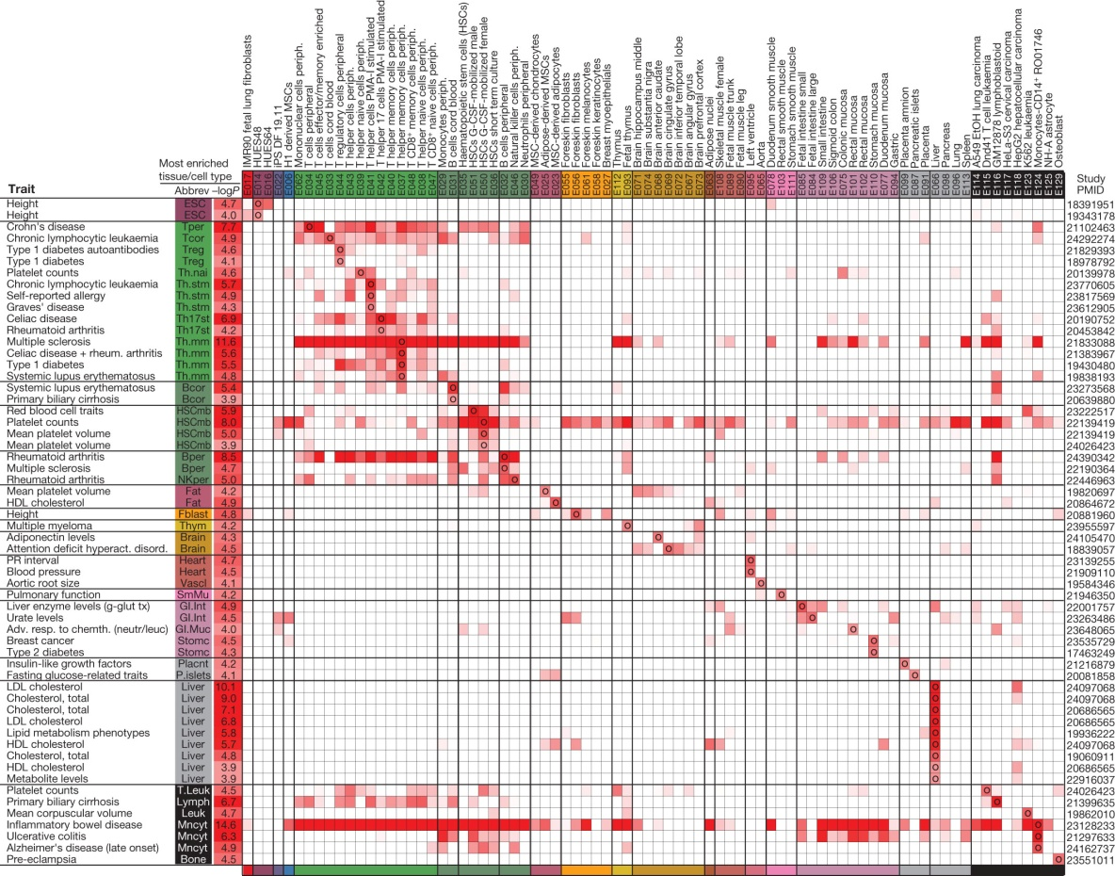
Epigenomic enrichments of genetic variants associated with diverse traits.

Slide 77
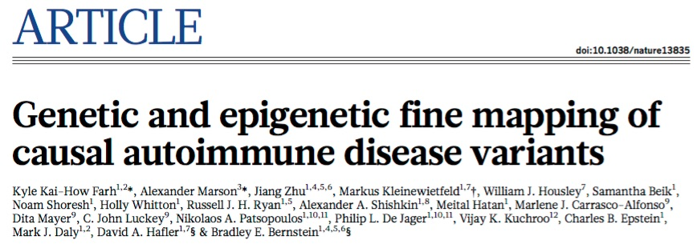
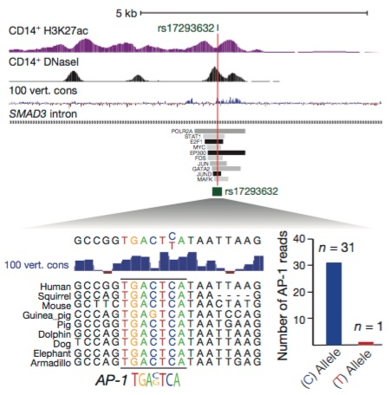

Slide 78
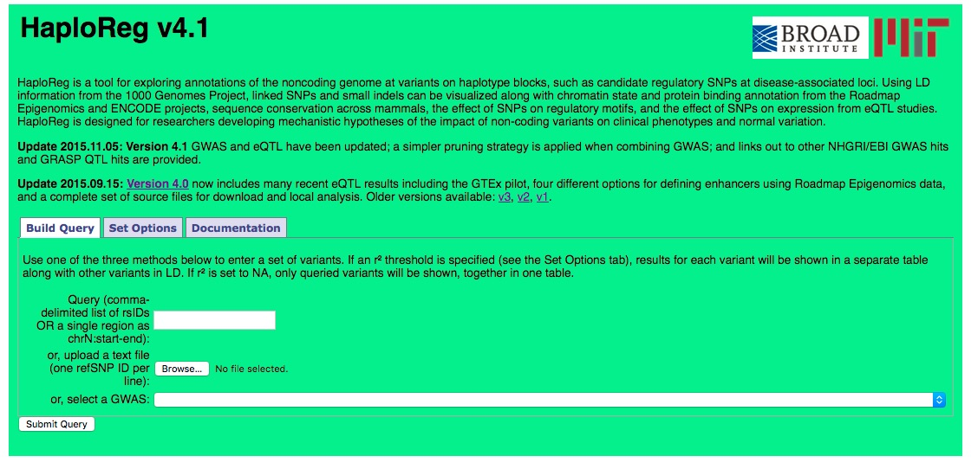
HaploReg
http://www.broadinstitute.org/mammals/haploreg/haploreg.php
Also see RegulomeDB at: http://regulomedb.org/

Slide 79
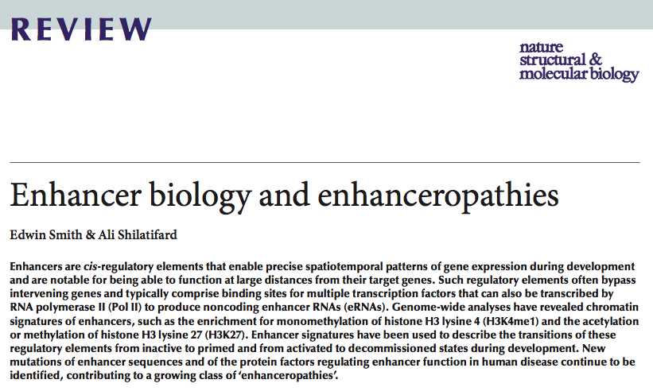

Slide 80

Future work
Epigenome dynamics. Current maps are basal state.
Systems approach to biology; novel target identification; precision genomic medicine
Do more integrating!
Civelek, M. & Lusis, A. J. Nat Rev Genet 15, 34–48 (2014).

Slide 81
Thanks!
Barry Grant
You

Slide 82
The Parker Lab, University of Michigan
Stephen C. J. Parker
Assistant Professor
email: scjp@umich.edu
web: theparkerlab.org

Slide 83
Extra slides

Slide 84

Molecular profiling of cells
Images from NHGRI
Notes:
Diversity of HTS experiments – align to reference genome to reveal biological signals

Slide 85
Molecular profiling of diploid cells
Images from NHGRI

Slide 86
Molecular profiling of diploid cells with heterozygous sites
A
G
Images from NHGRI

Slide 87
Molecular profiling→ health and disease
A
A
A
A
chr8^{risk}
gene (high)
A
//
Disease
Relevant
Cell/Tissue
G
chr8^{non-risk}
gene (low)
G
//
chr8^{risk}
gene (off)
Non-relevant
Cells/Tissues
A
//
chr8^{non-risk}
gene (off)
G
//

